Slide 1
NUMBER SYSTEM CONVERTER
BY
BADDAM PRUTHVIDHAR REDDY
BODEDDULA JEEVAN REDDY

Slide 2
Overview
Number system become increasingly popular as computers and digital technology have become more prevalent in our daily lives. There are several different numerical systems, including binary, decimal, octal, and hexadecimal, each with its unique representation and use cases.numerical systems. In the following sections, we will explore different types of number conversions and how they work
Types of number systems that we discussed are :
Decimal
Binary
Octal
Hexa decimal

Slide 3
IMPORTANCE
Understanding number systems is essential for performing mathematical operations and solving real-world problems.Different number systems have different properties and limitations that affect their use in various applications.Knowledge of number systems is necessary
Computer science: Number systems are essential to computer science, as computers operate on a binary number system (base 2). In addition, hexadecimal and octal number systems are also used in computer science to represent and manipulate data.
Engineering and science: Number systems are important in engineering and science, as they are used to measure and analyze physical phenomena. For example, the decimal system is used in the metric system to measure length, mass, and time, while the binary system is used to represent signals in electronic circuits.

Slide 4
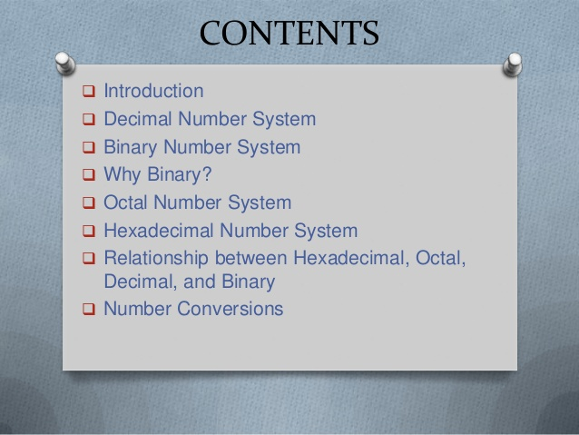

Slide 5
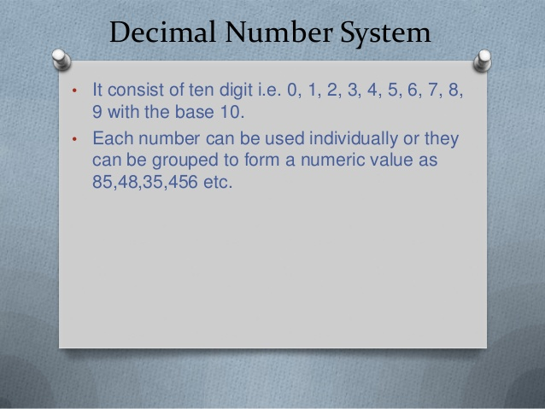

Slide 6
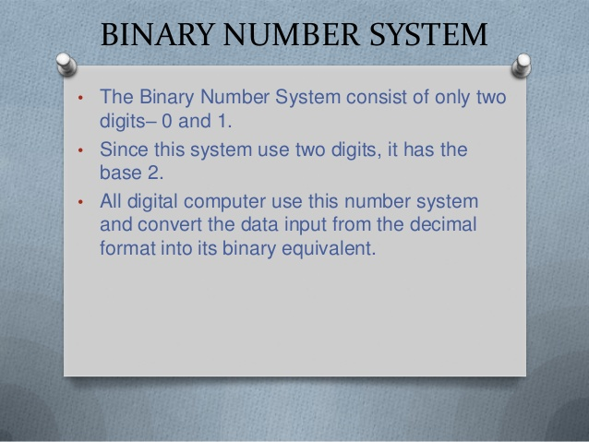

Slide 7
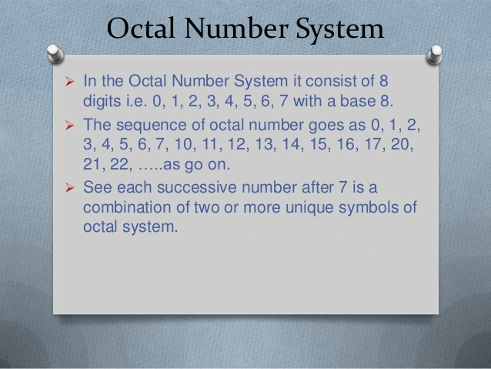

Slide 8
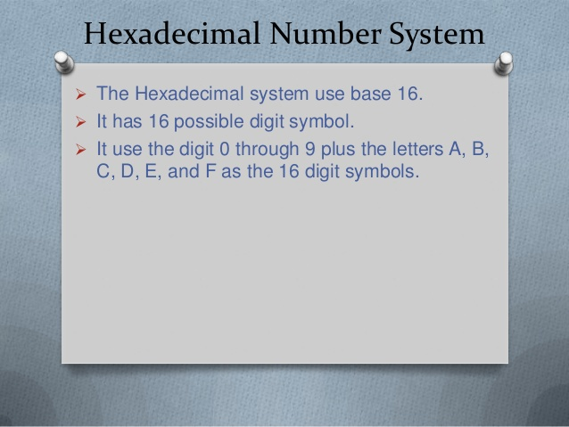

Slide 9
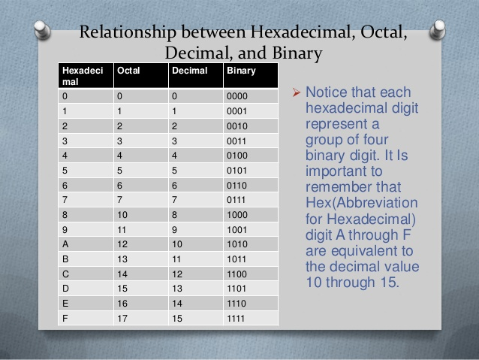

Slide 10
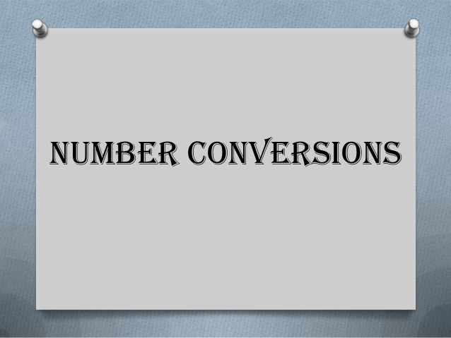

Slide 11
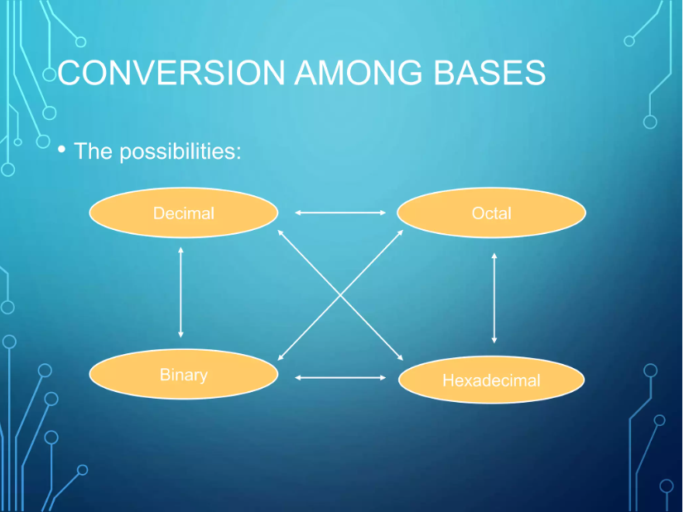
FLOW DIAGRAM

Slide 12
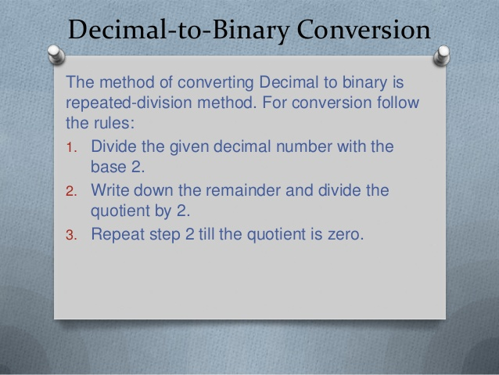

Slide 13
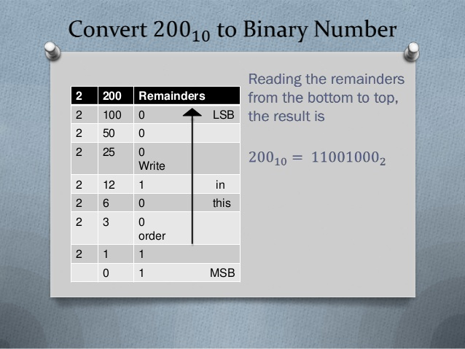

Slide 14
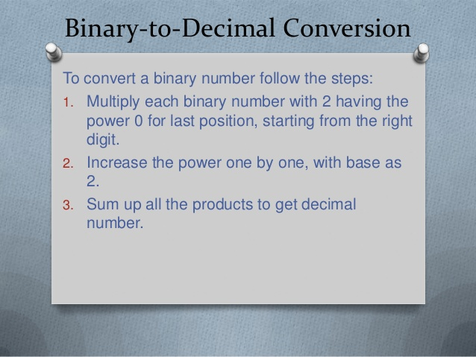

Slide 15
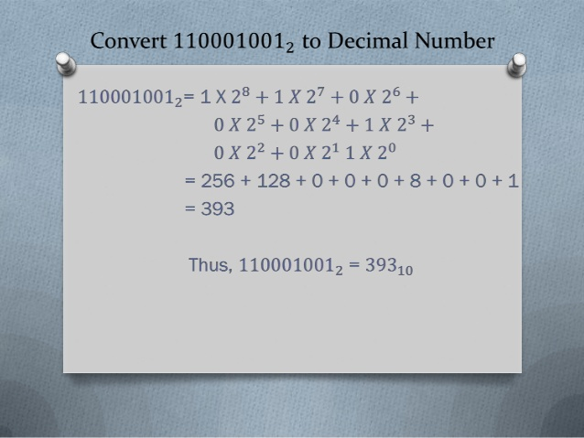

Slide 16
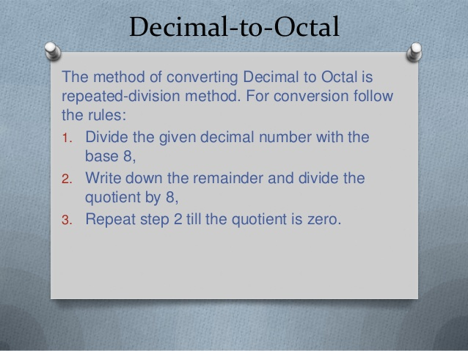

Slide 17
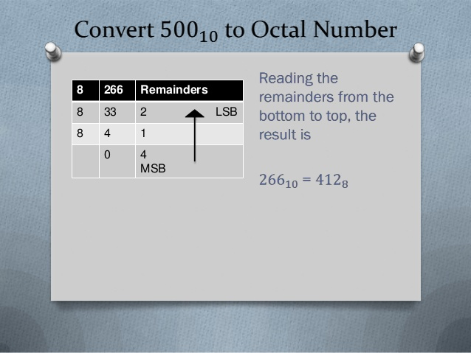

Slide 18
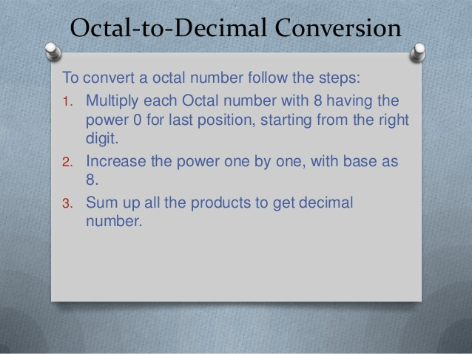

Slide 19
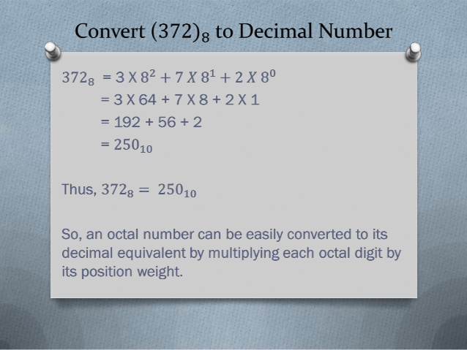

Slide 20
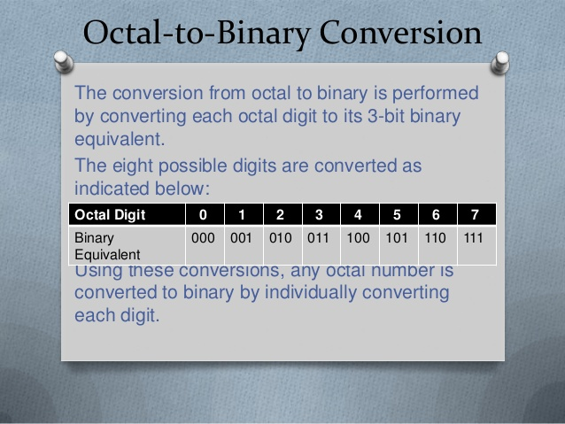

Slide 21
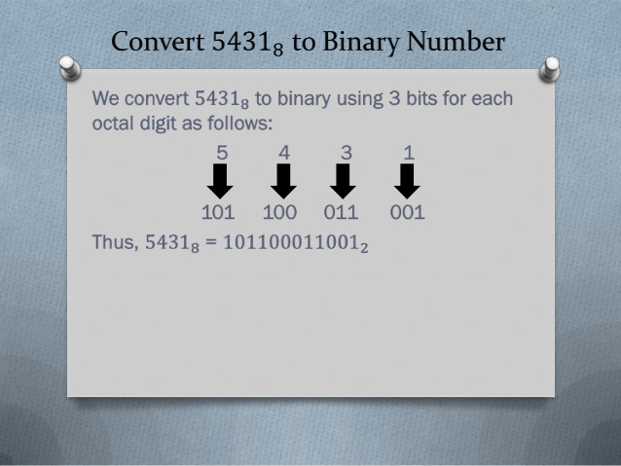

Slide 22
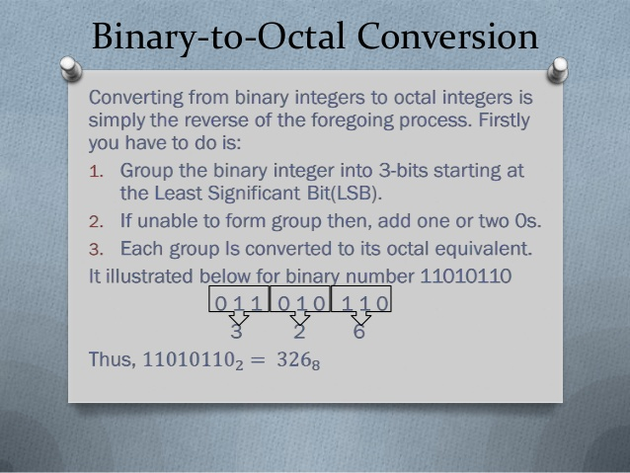

Slide 23
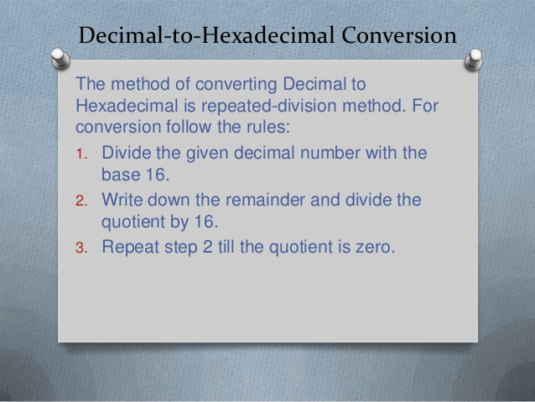

Slide 24
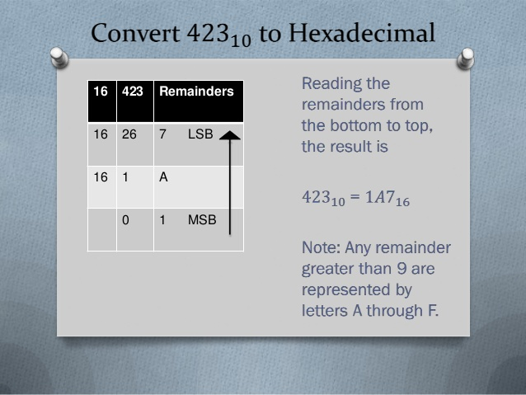

Slide 25
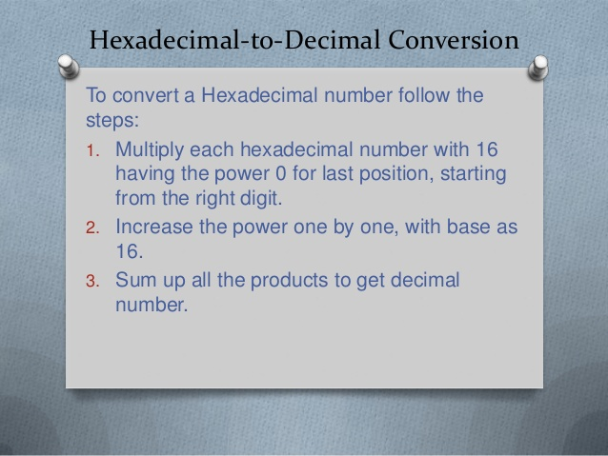

Slide 26
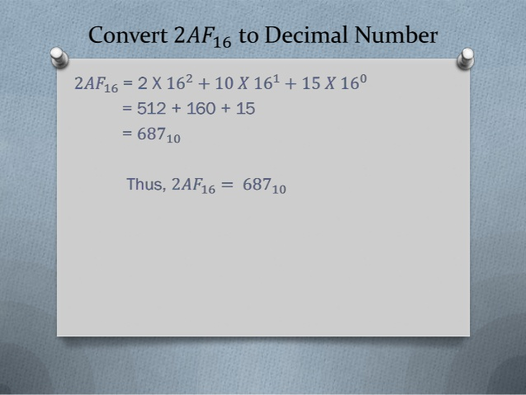

Slide 27
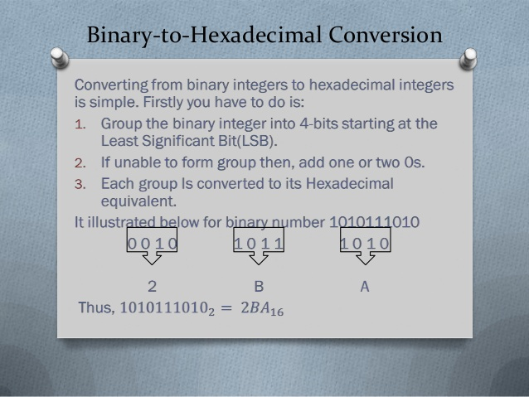

Slide 28
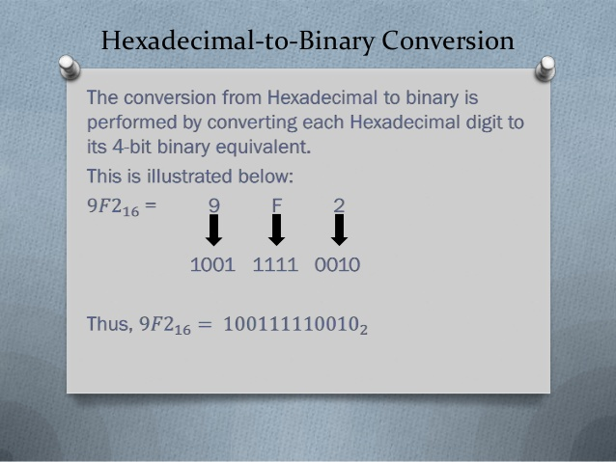

Slide 29
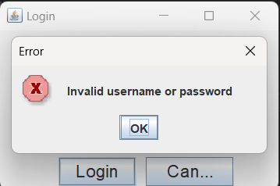
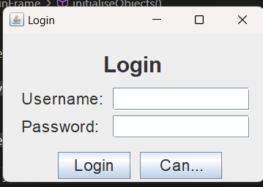
Screen shots

Slide 30
SCREEN SHOTS
The GUI includes a title, two labels for the username and password fields, two corresponding text fields, and two buttons for logging in or canceling the operation. The program implements the ActionListener interface to handle button clicks and validate the user's input. If the user enters correct login credentials, a new SwingConverter window is displayed. If the user enters incorrect credentials, an error message dialog box is displayed. The program runs by creating an instance of the LoginFrame class and setting it to visible.

Slide 31
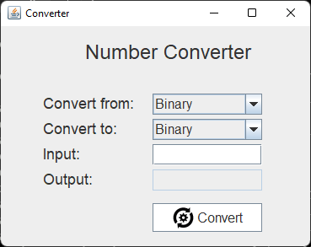
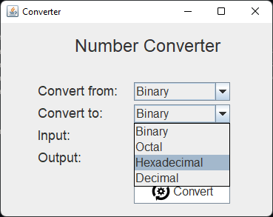
SCREEN SHOTS

Slide 32
conclusion
In conclusion, number converter systems are important tools that allow us to convert numbers from one base to another. The most commonly used number systems are the decimal system, which is used for everyday counting and calculations, and the binary system, which is used in digital electronics and computing. The octal and hexadecimal systems are less commonly used, but they are still important in some computer systems and programming languages.
Converting numbers between different systems involves understanding the positional values of each digit in the given number and multiplying each digit by its corresponding positional value. With the help of number converter tools, this process can be done quickly and accurately, making it easier to work with numbers in different systems.

Slide 33


